Slide 1
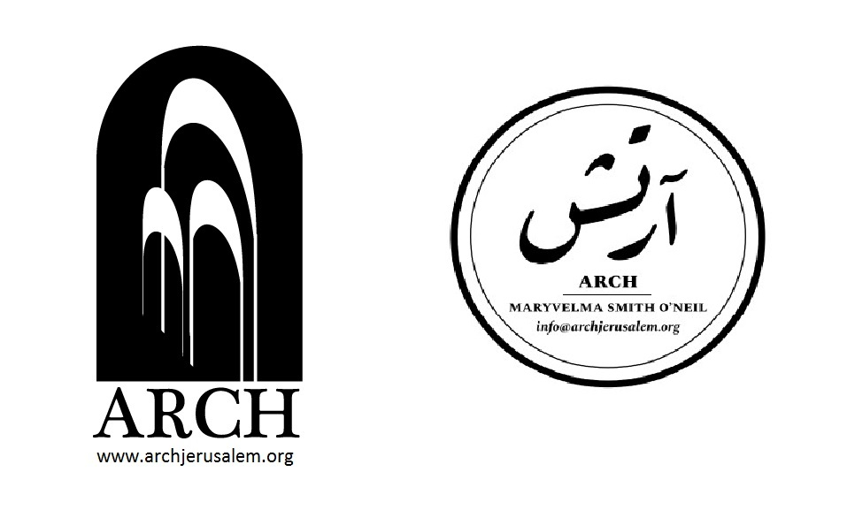
“ONE GIANT HOUSE”:
THE ROLE OF CIVIL SOCIETY IN JERUSALEM IN WAQF PROTECTION
Dr. Maryvelma O’Neil
ARCH
Alliance to Restore Cultural Heritage in Jerusalem

Slide 2
‘One Giant House’
“Looking at the Old City of Jerusalem from the sky, one would think that it was composed of one giant house. This is because almost all the houses are connected, having common walls with their roofs overlooking each other.”
Ghoshen, S. (2013) Jerusalem. Arab Social Life, Traditions and Everyday Pleasures in the 20th Century (Northampton, MA: Interlink Books).

Slide 3
Overall Research Aims
Our research sought to:
Evaluate impact of civil society organisations that are committed to sustaining Palestinian identity and cultural heritage in East Jerusalem, especially considering Palestinian National Plan Culture Sector Strategic Plan Summary 2011–2013 (CSSP 2011–13)
Survey children and youth on Palestinian identity and culture

Slide 4
Interviewees
Leaders of 10 Jerusalem-based civil society organisations were interviewed during the winter of 2017
Burj Al-Luq Luq Social Center Society
Center for Jerusalem Studies of Al-Quds University
Educational Bookshop*
Al Hoash – Palestinian Art Court
Jerusalem Tourism Cluster*
Al Ma’mal Foundation for Contemporary Art
Palestine Heritage Museum*
PASSIA – Palestinian Academic Society for the Study of International Affairs
Welfare Association (Old City of Jerusalem Revitalisation Programme)
Yabous Cultural Center
*Non-NGO. Educational Bookshop is a local commercial enterprise which also helps to arrange and support book launches, exhibitions, film screenings and robust debates on the Palestine question; Jerusalem Tourism Cluster is a non-profit tourism network; Palestine National Heritage Museum is a non-profit museum

Slide 5
Palestinian National Plan
Culture Sector Strategic Plan Summary, 2011-2013
Culture is an essential resource which has an important contribution to make to the Palestinian struggle. The PNA has presented the role of culture in the following terms:
As [culture] is capable of providing perseverance capacities and enriching national identity, culture is a significant weapon in the liberation battle.
Culture is a component of the national (cultural, social and symbolic) capital, which promotes individual and collective capacities to confront the occupation and various challenges as well as to support the capability of interacting with and reproducing life.
Palestinian National Plan 2011–13: 2

Slide 6
Objection #1
“PNA’s limited institutional capacity has prevented it from outlining a concrete and productive cultural policy. It is not truly utilized and mainstreamed into strategies and activities and translated into implementable programs on the ground.”
Imad Muna, Educational Bookshop

Slide 7
Objection #2
Cultural/social/symbolic capital should be interpreted as “any activity that expresses the Palestinian way of life and identity, whether it be scientific or artistic creation, including popular customs, stories and folktales.”
Khaled Khatib, Director of the Palestinian Heritage Museum

Slide 8
Objection #3
The excellence and uniqueness of Palestinians should extend beyond the limited horizon [of CCSP 2011-13] to encompass “wider interactions with the world. Throughout its history, Jerusalem has in many ways functioned as a microcosm of this world.”
Jack Persekian, Direction and Curator of Al-Ma’mal Foundation for Contemporary Art

Slide 9
Objection #4
“Development of strategic plans under the occupation is ineffective since unexpected costs cannot be predicted or mitigated, not to mention plans that extend over a period of three or four years, where dynamics can change unexpectedly and drastically.”
Rania Elias, Director, Yabous Cultural Center

Slide 10
Strategic Responses of Civil Society in Jerusalem
in Waqf Protection
Strategic Response #1:
Architecture as a means of civil disobedience
Yabous Cultural Center
The mission of Yabous – “Human rights cannot be separated from cultural rights; they are interconnected.“ (Rania Elias, Yabous Director)
Elias and Yousef Anastas, Bethlehem-based architects who designed Yabous sought to make entering building an act of collective Palestinian civil disobedience conducted in open defiance of exclusionary Israeli policies imposed through city.
Visitors proceed through large, curtain-like, transparent façade panels. Full-length, refractive steel screens transmit a kinetic effect which continues to promote interaction with passers-by when closed.

Slide 11
Strategic Response #2:
Creative civil disobedience
Palestinian Art Court - Al Hoash
This Sea is Mine used contemporary art to reflect upon Palestinian cultural landscape. Brought 16 art and cultural organization together, under umbrella of Qalandia International to participate in local art event.
RE/viewing Jerusalem – Palestinian Art Court (Al-Hoash). Brought Palestinian and international artists together at six stations (ranging from Al-Hoash to Burj Al-Luq Luq). They were reclaimed for artwork with the intention of creating urban artistic interventions.
Alia Rayyan (former Al-Hoash director) describes refusal of Palestinian artists to apply for required municipal permission: “It was a political decision that was fundamental to us. In these circumstances – under Israeli occupation – there are some things we cannot escape, but we need to find forms of civil disobedience.”

Slide 12
Strategic Response #3:
State-building
PASSIA
PASSIA sets out the internal strengths and institutional resources held by the State of Palestine in its annual directory. Annual theme focuses on Palestinian cultural heritage; engagement with distinguished artists, writers and intellectuals is a means of recollection and reinforcing national identity.
It also promotes a culture of human rights through an array of capacity-building workshops and publications

Slide 13
Strategic Response #4:
Preservation of architectural heritage
Welfare Association (Old City of Jerusalem Revitalization Program)
“…The preservation of our architectural heritage automatically leads to the preservation of a large proportion of our national knowledge and identity.”
Fida Touma, Director, Welfare Association, Old City of Jerusalem Revitalization Program

Slide 14
Strategic Response #5:
Establishment of non-profit network that promotes Palestinian identity
and acts as economic engine
Jerusalem Tourism Cluster (JTC)
JTC is a significant ad hoc tourism infrastructure for East Jerusalem cultural and tourism sectors.
It contributes to the development of the concept of tourism in East Jerusalem through community involvement, programs and events promoting community tourism.
It also produces numerous publications and booklets by experts in the field.

Slide 15
Surveys
Two surveys commissioned in 2017:
Measured awareness and engagement of children/youth about each organization’s activities (233 surveys distributed at PalVision)
100 Jerusalemite university students were asked 10 structured questions that solicited comment on cultural heritage and Palestinian identity.

Slide 16
Organisation | % Familiar with | % Not familiar with | % Usefulness to Jerusalem: Very useful + Useful
Buj Al-Luqluq Social Center Society | 89.8 | 10.2 | 40
Center for Jerusalem Studies of Al-Quds University | 14.3 | 6.1 | 12.2
Educational Bookshop | 49 | 51 | 18.4
Edward Said National Conservatory of Music | 89 | 8.2 | 28.6
Al-Hoash – Palestinian Art Court | 30.6 | 16.1 | 16.3
Jerusalem Tourism Cluster | 12.3 | 2.0 | 8.1
Al-Mamal Foundation for Contemporary Art | 8.2 | 4.1 | 4.1
Palestine Heritage Museum | 71.4 | 28.6 | 32.7
PASSIA – Palestinian Academic Society for the Study of International Affairs | 18.4 | 81.6 | 4.1
Welfare Association (Old City of Jerusalem Revitalisation Programme) | 28.6 | 71.4 | 10.2
 | 69.4 | 30.6 | 26.6

Slide 17
Question #1
What does Palestinian identity mean to you? Responses condensed and provided in percentages
57% - A sense of belonging and steadfast rootedness
55% - Pride
50% - Institutional racism/discrimination against Palestinians
47%% - Resistance
42% - Palestinian culture
38% - Arab language

Slide 18
Question #2
Where do you feel that this identity is expressed?
For example, at concerts of Palestinian musician, through embroidery, literary works, cultural events, dabke, contemporary culture, etc.
56% - All of the above
40% - Literary works, especially poetry
17% - Dabke
15% - Folkloric songs
14% - Cultural events

Slide 19
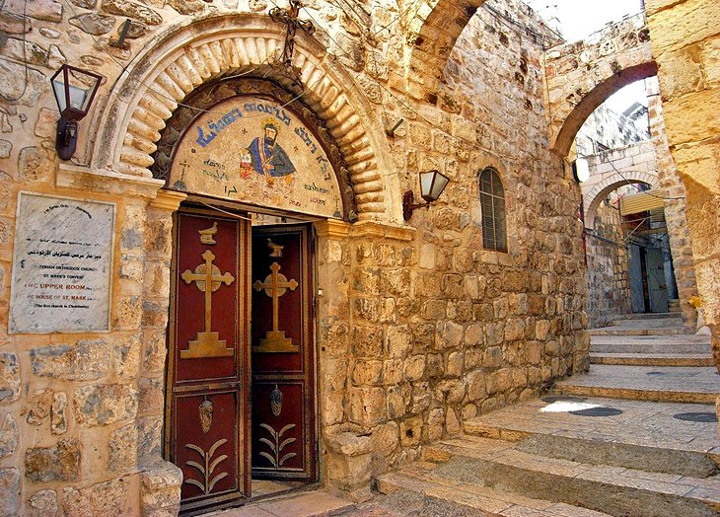
Question #3
What communities and groups shape Palestinian identity?
When you think of this identity do you think about Armenians, Greeks, Copts, Syrians, the Diaspora?
38% - Yes
27% - No
19% - Did not respond/indecipherable answers
12% - Only Palestinians in exile form part of the Palestinian identity
11% - No awareness

Slide 20
Question #4
Do you see the African community as a component/a part of this Palestinian identity? If so, how?
44% - No
43% - Yes (Among these, some recognized that the injustices they have suffered also make them part of Palestinian identity)
33% - They have their own history/culture and are not part of the Palestinian community

Slide 21
Question #5
Do you see the Domari community as a part of this identity? If yes, why?
54% - No (36 without explanation). Others stated that since they have their own history/identity/culture/traditions, they are not part of Palestinian community. Their makeup and way of dressing are different. Their commonality is suffering from Israeli injustice.
21% - Yes (5 explained that even though they are different, they still form part of the Palestinian identity)
17% - No awareness

Slide 22
Question #6
Do you think Palestinians have succeeded in keeping their identity alive, despite the occupation? If so, why?
47% - Yes. 28 said that protection of this identity is due to efforts of Palestinian civil society, especially cultural events.
33% - No. 26 without explanation. 18 of those who gave explanations said that Palestinians have failed to preserve their identity because of the occupation. Others said that Palestinians lost a lot through negotiations.
10% - Stated that identity has been preserved because Palestinians are stubborn, because they have not yielded to the Judaisation of Jerusalem
6% - Israelis have control over everything
6% - END THE OCCUPATION

Slide 23
Question #7
Students were asked to reflect upon the disorientation experienced by Mahmoud Darwish: “In Jerusalem, and I means within the ancient walls/I walk from one epoch to another without a memory to guide me.” The subsequent question asked. “What can be done to better protect Palestinian Jerusalem where traditional ways of life (both material and non-material) are increasingly threatened?”
46% - Better preserve the history of Palestine. Refuse to abandon identity. Create more cultural associations to preserve language and culture. Organize more cultural events.
37% - Refuse to abandon identity as expressed in culture and traditions and resist Israeli attempt to Judaise the city.
16% - Raise awareness about the importance of Palestinian culture and identity
13%- Boycott Israeli products
13% - Forge Palestinian unity/reconciliation between the different political factions

Slide 24
Conclusions
Rania Elias takes a principled and courageous approach:
Yabous refuses to acknowledge and construct its programs around this structural inequality because it implies acceptance of the annexation of Jerusalem and a negation of the wider framework of national rights and obligations, thereby restricting them to demands of equality instead of liberation and freedom.
In the face of the institutionalised Israeli system which reproduces repression, dispossession and de-development, we must preserve cultural heritage in Jerusalem and revive the city, restoring its status and preserving its identity.

Slide 25
Dr Safa Nasser Eddin urges steadfastness and sharp-eyed realism:
Our problem as Palestinians is that we are always optimistic and hopeful, which ensures that we do not surrender and therein assimilate our own reality. Nonetheless, we need to be realistic within this current political spectrum. I do not see major prospects for a breakthrough that would eliminate these ever-increasing inequalities.

Slide 26
Dr Mahdi Abdul Hadi encourages Jerusalemites to hold their ground:
It is crucial that we maintain our presence here on the cultural, social and political levels. What is happening now is that Ramallah is replacing Jerusalem as the heart of Palestine, a process that is consciously encouraged by Israel both directly, through closures of institutions like Orient House, or indirectly, by severing the links between Palestinians in Jerusalem and the West Bank.

Slide 27
Architect Fida Touma sketches a grim blueprint:
Prospects for true change and development are non-existent as the effectiveness of the work of different actors in Jerusalem is in no way sustainable with the persistence of the occupation. What these organisations do is to provide services to maintain the bare minimum for a dignified life. This also keeps Israel happy because our work enables them to maintain a minimum level of humanity before the international community.

Slide 28
Raed Saadeh Issues a Clarion Call to Jerusalemites Collaborate and Strategize to Forge Greater Unity:
Prospects for change are non-existent so long as the Jerusalemite community does not comprehend that it needs to take the lead to create and develop its framework and contexts for collaborative work, including setting of strategies, as well as forging networks and partnerships on the local, national and international levels. The dynamics in Jerusalem differ from the remainder of the West Bank due to its isolation and systematic targeting. Consequently, focus on inclusiveness in Palestinian national identity is strategically imperative.

