Slide 1
THE DIGITAL RECONSTRUCTION
OF JERUSALEM’S LOST MUGHRABI QUARTER &
THE ILLÉS RELIEF DIGITAL MAPPING INITIATIVE
Dr. Maryvelma O’Neil

Slide 2
Pilot Project Mughrabi Quarter Digital Archive
Few spaces are more emblematic of Jerusalem today than the Western Wall Plaza.
Yet few people—including both Palestinian and Israeli residents of Jerusalem alike—
are aware of the destruction that enabled this space.

Slide 3
Zeppelin Photo of Mughrabi Quarter, 1931

Slide 4
MUGHRABI QUARTER DEMOLITION PLAN AND AERIAL PHOTO (1931)
Photo: Israel State Archives GL - 3847/4.
Photo: Archiv der Luftschiffbau Zeppelin GmbH, Friedrichshafen, 193/008.

Slide 5
DIGITAL RECONSTRUCTION OF DESTROYED MUGHRABI QUARTER
http://www.mughrabiquarter.info/archive.html
• Web-based
• Digital palimpsest where multiple versions of events and relevant historical phenomena are overlaid
• Interactive and globally accessible virtual archive containing historical records, documents, artifacts, oral histories and testimonies, and other primary and secondary source materials and media

Slide 6
4.5 by 5 metre (15 by 16ft)
ILLÉS RELIEF MODEL OF JERUSALEM (1873) 1:500 scale

Slide 8
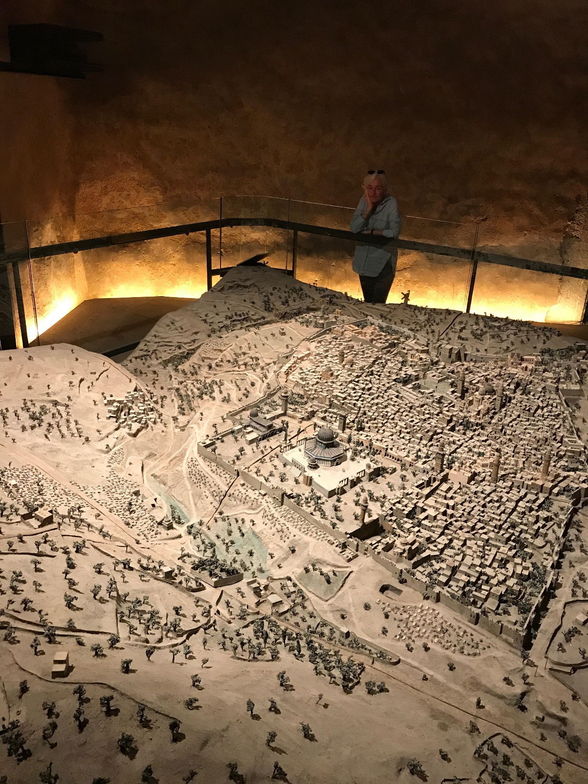

Slide 9
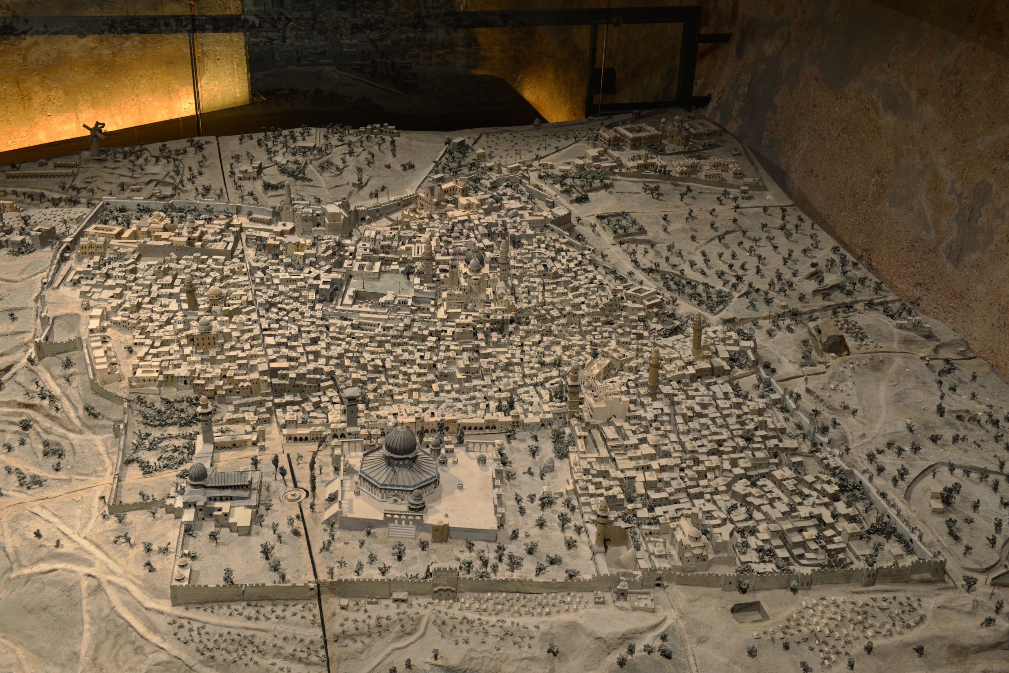

Slide 10
Illés Depth Elevation

Slide 11
Illés Orthographic

Slide 12
Only six gates are shown along the city walls: Jaffa Gate, Damascus Gate, Lions' Gate, the sealed Gate of Mercy (Golden Gate), Dung Gate and Zion Gate. Herod's Gate, missing in the model, was reopened in 1874, and the New Gate was added only in 1889.
German Church of the Redeemer is marked by a solitary German flag, while David's Citadel is still surrounded by the moat which was later filled in for the visit of German Kaiser Wilhelm II (1898).

Slide 13
Illés reproduced every street and alley in the city and almost every building.
Included flags on the churches, a small cannon on top of one of the towers of the Citadel, telegraph lines, which were installed in the city in the mid-1860s, and even signs on some of the shops.
Model weighs a ton/Was built in 8 sections for easy transport.
Made of strips of beaten zinc mounted on a wooden platform.

Slide 14
MASTER PROJECT:
THE ILLÉS RELIEF DIGITAL MAPPING INITIATIVE

Slide 15
WHAT IS DIGITAL MAPPING?

Slide 16
DIGITAL MAPPING IS THE PROCESS BY WHICH A COLLECTION OF DATA IS COMPILED AND FORMATTED INTO A VIRTUAL IMAGE. THE VIRTUAL IMAGE IS USUALLY 3D.
Spatial map of Notre-Dame using more than a billion laser-measured points to recreate a virtual replica.

Slide 17
MASTER PROJECT:
THE ILLÉS RELIEF DIGITAL MAPPING INITIATIVE
• Collaborative research initiative to digitally map the entire Illés Model using latest technologies via contributions from scholars and institutions around the world
• Digital palimpsest where multiple versions of events and relevant historical phenomena are overlaid
• Interactive and globally accessible virtual archive containing historical records, documents, and artifacts,
oral histories and testimonies, and other primary and secondary source materials and media

Slide 18
“Real imagination is technical imagination,” the British painter, Francis Bacon, observed, in 1952. “It is in the ways you think up to bring an event to life again.”
Link to Demo Video

Slide 19
Next Phase
Virtual Illés Model will be displayed as an experiential, spatial immersion installation designed to travel to sponsoring institutions.
Immersive theatre application: application tailored to projection-mapped museum environment, using handheld controllers.
Can be projected in 3D stereo for use with active-3D systems.

